Slide 1

The Next Generation Cyber Security in the 4th Industrial Revolution
Alvin Tan
Regional Head

Slide 2
Today’s Problem
=
World of Cybersecurity
World of Technology
(IT, OT and IoT)
The world of technology and the world of the security designed to protect technology are moving in opposite directions

Slide 3
6 Major Trends
Simpler and Easier
More Convenient
Fewer People
World of Technology
Natively Integrated
More Automated
Designed to Prevent

Slide 4
6 Major Trends
More Difficult
Simpler and Easier
More Complicated
More Convenient
More People
Fewer People
World of Cybersecurity
World of Technology
Isolated
Natively Integrated
Mostly Manual
More Automated
Reactive Response
Designed to Prevent

Slide 5
6 Major Trends
More Difficult
Simpler and Easier
More Complicated
More Convenient
More People
Fewer People
“U-Turn”
Isolated
Natively Integrated
Mostly Manual
More Automated
Reactive Response
Designed to Prevent

Slide 6
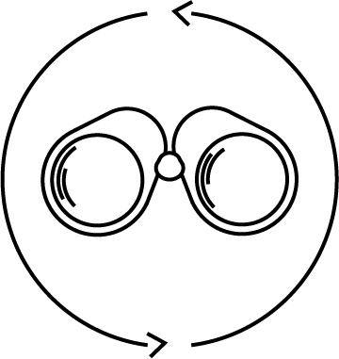
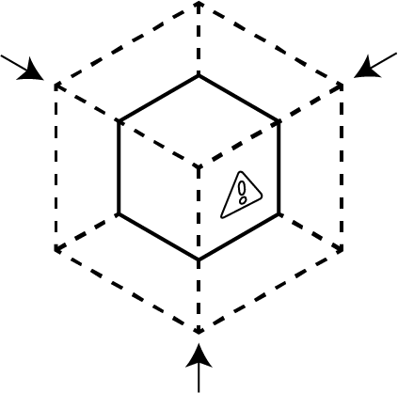
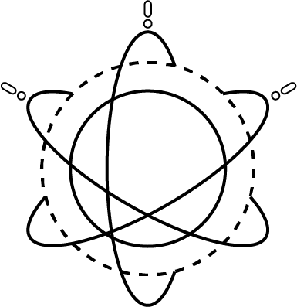

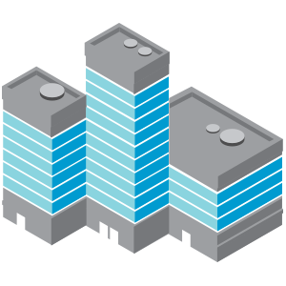
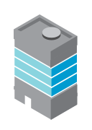
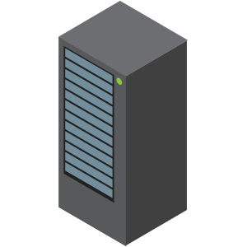



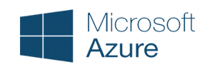


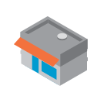









Preventing Successful Attacks
COMPLETE VISIBILITY
REDUCE ATTACK SURFACE
PREVENT KNOWN THREATS
PREVENT
NEW
THREATS
CONSISTENT ACROSS ALL
Business Locations
Headquarters
Branch Offices
Data Center/ Private Cloud
Public Cloud
SaaS
MOBILE USERS
IoT
© 2018 Palo Alto Networks Inc. Confidential

Slide 7


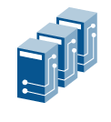
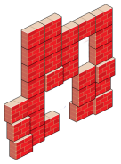
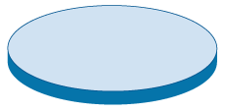







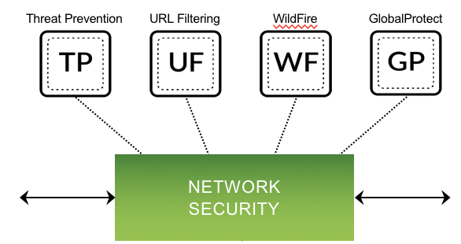

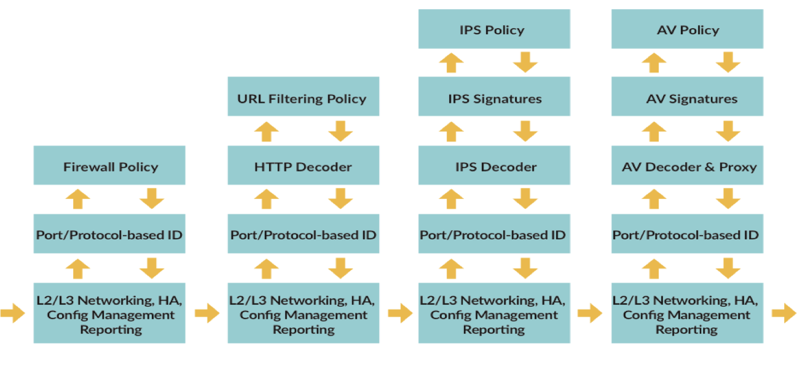
We need a different approach to Network Defence
Single Pass Parallel Processing (SP3™)
DNS detection
for outbound DNS
Internet
Enterprise network
APT detection
for port 25 APTs
APT detection
for port 80 APTs

Slide 8


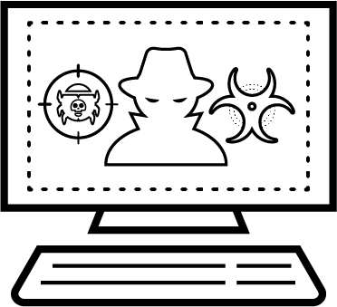







We need a different approach to Endpoint Defence
ANTIVIRUS
HOST FW
HOST IPS
HOST APT
APPLICATION CONTROL
EDR
Multi-method prevention rather than multi-agent on the endpoint
Malware
Exploit
EXECUTION
RESTRICTIONS
MACHINE LEARNING
LOCAL ANALYSIS
RECONNAISSANCE
CODE EXECUTION
KNOWN MALWARE
SANDBOX
DYNAMIC ANALYSIS
MEMORY CORRUPTION
ESCALATION

Slide 9



Bringing both approaches to the Cloud
Cloud Application
WEB
APP
INLINE
Protect and
Segment Cloud Workloads
HOST
Secure OS
& App Within Workloads
Web
Server
App
Server
IaaS
API
Continuous Security & Compliance
On-Premise
PaaS
API
Object Storage
Caching
Database

Slide 10





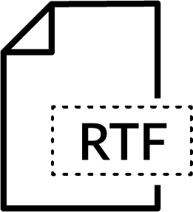
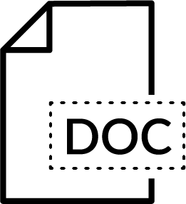
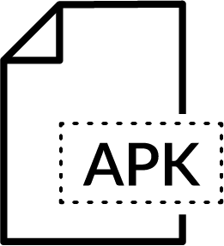
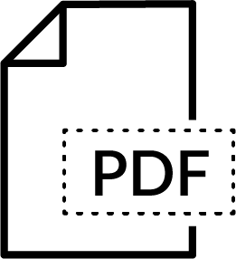
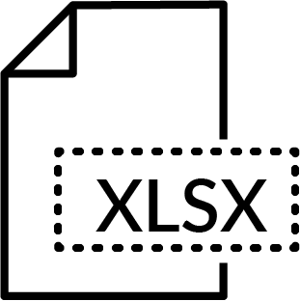


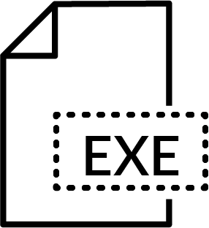

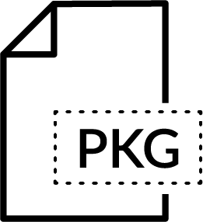
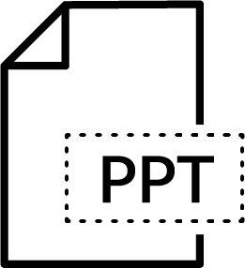
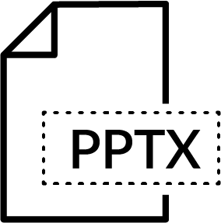
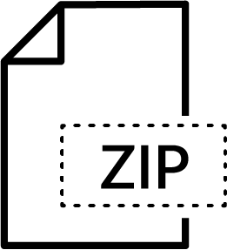
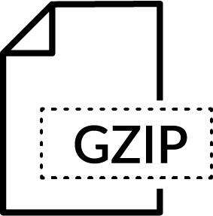

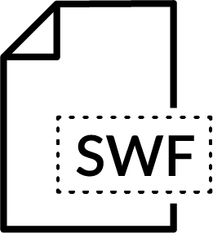
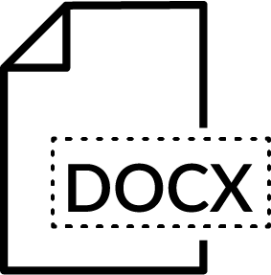
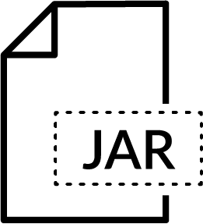
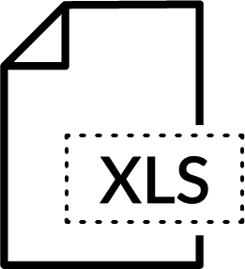



Leveraging the Cloud
DYNAMIC ANALYSIS
MACHINE LEARNING
STATIC ANALYSIS
BARE METAL
MALWARE SIGNATURES
WINDOWS
EXECUTABLES
EVERY 24 HOURS
JAVA, EXE, DLL, ZIP, PDF, DOC, FLASH, APK, DMG, PKG, MACH-O
FIREWALLS

Slide 11
Leveraging the Cloud
DYNAMIC ANALYSIS
MACHINE LEARNING
STATIC ANALYSIS
BARE METAL
MALWARE SIGNATURES
MALWARE, URL’S, DNS, C&C
1,000/DAY
230,000 / DAY
WINDOWS
EXECUTABLES
EVERY 24 HOURS
5 MINUTES
JAVA, EXE, DLL, ZIP, PDF, DOC, FLASH, APK, DMG, PKG, MACH-O
FIREWALLS

Slide 12
Getting Consistent Security Everywhere
DYNAMIC ANALYSIS
MACHINE LEARNING
STATIC ANALYSIS
BARE METAL
MALWARE, URL’S, DNS, C&C
1,000/DAY
230,000 / DAY
WINDOWS
EXECUTABLES
EVERY 24 HOURS
5 MINUTES
JAVA, EXE, DLL, ZIP, PDF, DOC, FLASH, APK, DMG, PKG, MACH-O
Headquarters
Branch Offices
Data Center/ Private Cloud
Public Cloud
SaaS
MOBILE USERS
IoT

Slide 13
Indicators of Compromise vs Indicators of Attack
IP Address
Attack
MD5 Hash
URL

Slide 14
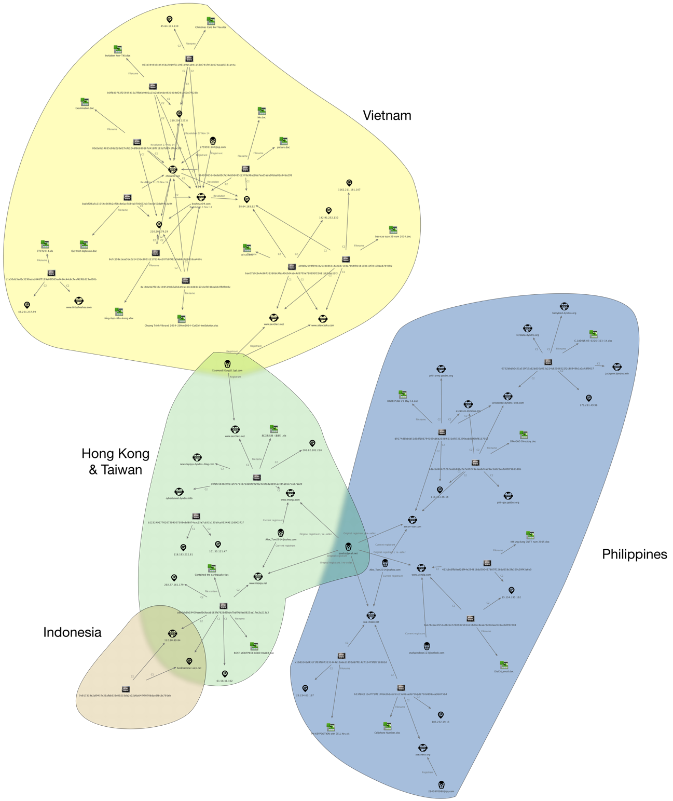
Mapping a Campaign - Operation Lotus Blossom
Separate, but overlapping infrastructure
Each targeted nation largely has its own C2 servers
Connected by email addresses used to register domains

Slide 15








DISRUPTING THE CONSUMPTION MODEL
THREAT PREVENTION
URL
FILTERING
THREAT INTEL CLOUD SANDBOX
THREAT HUNTING
API & Application Framework
THREAT SYNDICATION AND TRANSLATION
BEHAVIORAL ANALYTICS
AUTOMATED THREAT PREVENTION SERVICES
IN-HOUSE APP
DATA FROM LOGS & TELEMETRY
3rd PARTY APP
3rd PARTY APP
Headquarters
Branch Offices
Data Center/ Private Cloud
Public Cloud
SaaS
MOBILE USERS
IoT

Slide 16



atan@paloaltonetworks.com

